Slide 1
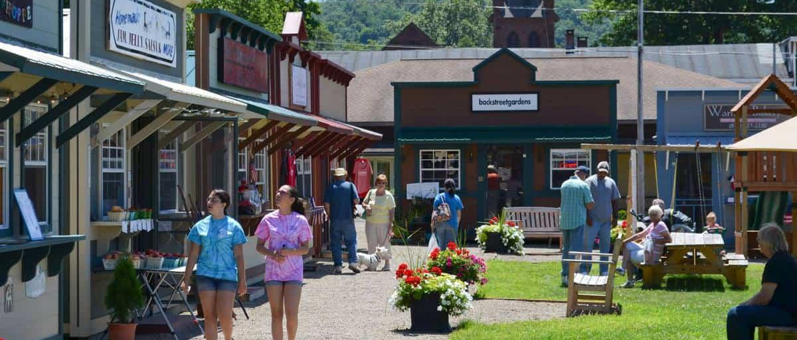
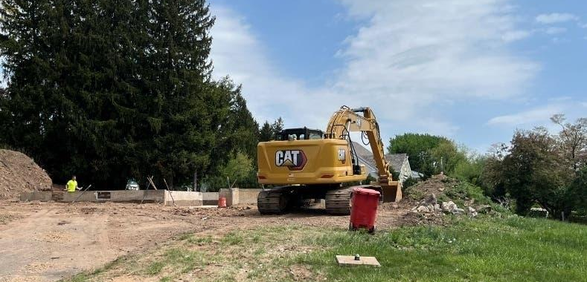
What is an Economic Development Corporation?

Slide 2
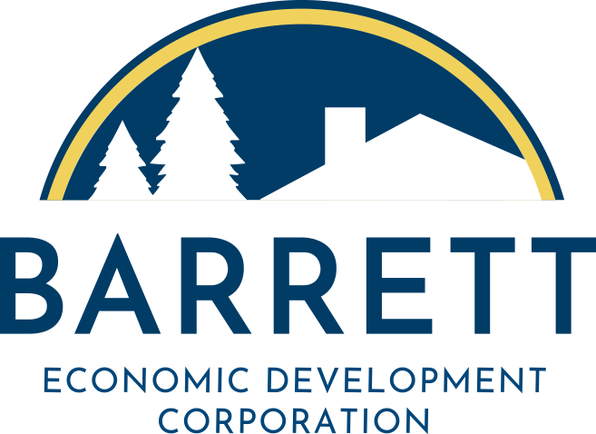
What is an
Economic Development Corporation?
An EDC is a non-profit organization (not a company), created to promote economic growth within a specific geographic area.
EDCs can do the following things:
Attract new companies to an area and/or help existing businesses expand
Apply for grants on behalf of a community
Issue grants, loans, or other incentives to support business development
Improve public infrastructure (roads, sewers, etc.) and help market sites to potential new businesses
Help create training programs and assist with workforce recruitment
Provide data, research and community input to inform how government addresses economic planning
Fund community projects like affordable housing, parks, and museums

Slide 3
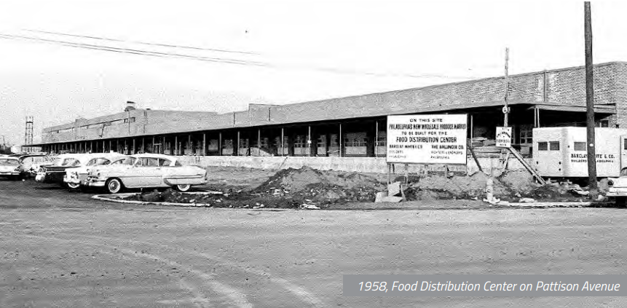
History of EDCs
EDCs popularized in the1960s with organizations like the Philadelphia Industrial Development Corporation and Bucks County EDC launching in response to manufacturing industries declining.
At the time, the federal government began pouring renewal dollars into communities with declining industrial base.
The way the federal grant programs were set up, EDCs were, and are, a necessary vehicle to capture these funds. Period.
Food distribution centers like this one in Philadelphia declined and sought expansion in cheaper areas outside of the City.
PIDC stepped in to provide financing to help buy land to expand new facilities within Philadelphia instead.

Slide 4
EDCs: From Cities to Rural Regions
Cities saw initial success from EDCs
→ As a result, rural communities banded together to create similar EDCs to bring investment to neglected areas
Northeastern Pennsylvania Alliance (NEPA), was founded in 1964
→ To serve the seven counties of Northeastern Pennsylvania including Carbon, Lackawanna, Luzerne, Monroe, Pike, Schuylkill and Wayne
Gave the region the ability to compete for government and private investment.
As steel industry declined
→ Bethlehem EDC formed in 1982; Lehigh Valley EDC formed in 1995

Slide 5
Case Study: NEPA Alliance Now
In 2024, NEPA accomplished many things for the region, including:
→ Helped to retain 1,344 jobs in the region
→ Helped secure $113,409,658 in government contracts awarded in the region and assisted 300 existing local businesses
→ Leveraged $3.44 million in ARC grants for regional and local organizations
→ Provided $24.5 million in loans, generating an additional $37.2 million in investment for existing local businesses
→ Through the Get Connected E-Commerce program, used $70,000 in grant funding to provide e-commerce platforms including websites and social media support to over 20 existing local businesses

Slide 6
Case Study: Lehigh Valley EDC Over Time
LVEDC organized in 1995 in response to major employers closing and to diversify its business community with employers of all sizes
Funds were raised to support economic development and transportation projects → created stability for the region and GDP grew from $25 million in 1995 to now $56 million in 2025
Median household incomes in the area increased by $17K to $81K over the past 5 years, outpacing inflation and exceeding the PA and National benchmarks.
LVEDC was crucial in securing $400 million PA SITES program that makes properties shovel-ready for development.
Launched an apprenticeship program promoting careers in advanced manufacturing

Slide 7
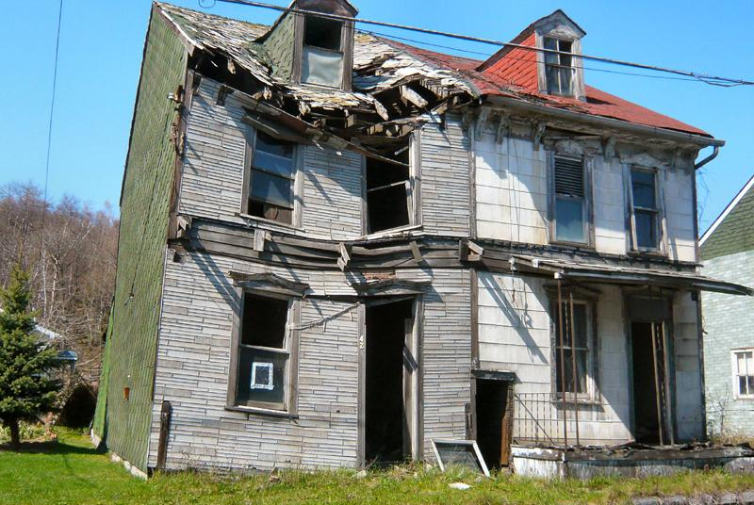
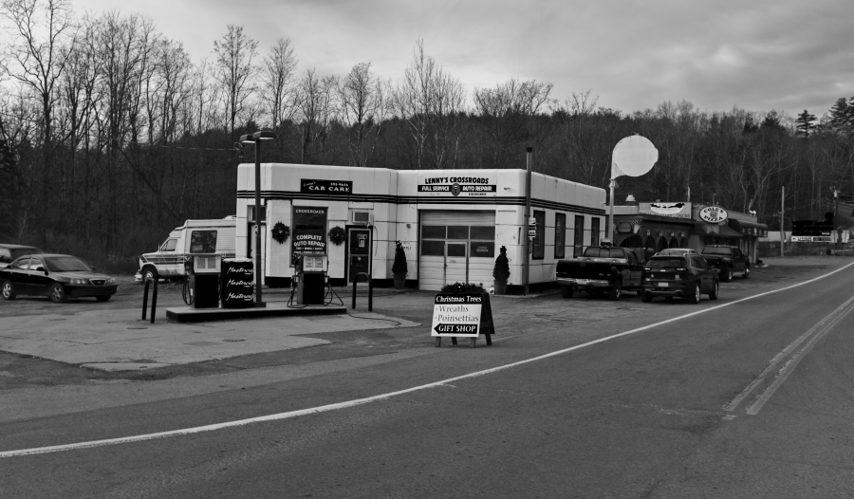
Why not bring this type of investment and these types of resources to Barrett?

